Slide 1
May 15-01: B&V 69/12KV SUBSTATION DESIGN
Matt Backes, Faran Malik, Ryan Jerve, Bhargav Gouni,
Sohail Suryavanshi
Project Website: http://may1501.ece.iastate.edu
Project Sponsor: Black and Veatch
Advisor: Dr. Venkataramana Ajjarapu

Slide 2
Agenda
Project Overview
Current Design
Design Process
Challenges and Test Plan
Demo
Notes:
Faran

Slide 3
Project Scope
Design a 69kV/12kV distribution substation for Black & Veatch to support an increased demand from a factory
Physical design
Control house and arrangement of equipment
Protection and Control design
Substation layout (One-line & three-line)
Selection of protection equipment and panel arrangements
Connections between protective devices, buses, and transformers
Connections to station control panels
Engineering management services
Notes:
Faran -The presentation will clearly state the scope of the project (try to explain this coherently, in simple terms -- main ideas and intuition behind them).
Protection and Control Design - one-line diagrams, three-line diagrams, equipment selection, panel arrangements,

Slide 4
Deliverables
First Semester (Fall 2014) | Second Semester (Spring 2015)
Engineering man-hour budget One-line Diagram Panel Layouts Control house Layout Protection Relay Schematics | Wiring Diagrams Physical Layout Communication and RTU Design Justifications Three-line Diagram
Notes:
Bhargav
We can extend on this by looking at the original project plan deliverables.
First bullets huge chunks

Slide 5
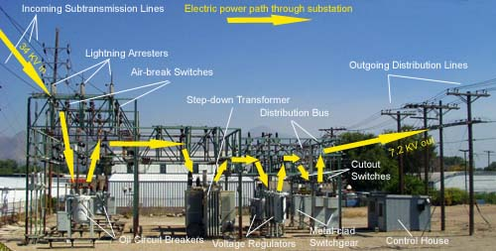
Substation Design Fundamentals
Bus Configurations
Circuit breakers and switches
Protection Relays
Communication Equipment
https://www.osha.gov/SLTC/etools/electric_power/illustrated_glossary/substation.html
Notes:
Ryan

Slide 6
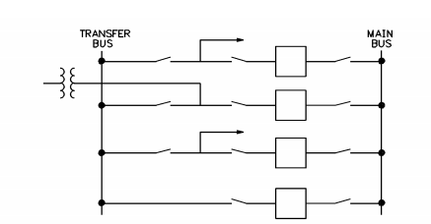
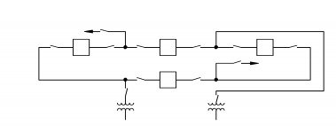
Bus Configurations
Single Bus
Sectionalized Bus
Main and Transfer Bus
Ring Bus
Notes:
Ryan

Slide 7
Current Design
Covington Substation
2 Incoming lines (69kV)
2 Outgoing feeders (13.2kV)
1 Bank
4 Current Transformers
2 Protection Relays
2 Circuit Breakers
6 Current Transformers
3 Protection Relays
1 Power Transformer (22.4MVA)
1 Circuit Switcher & 1 Circuit Breaker
2 Motorized Switches
Notes:
MATT
The presentation will clearly state the current design (block diagrams, pictures, etc. should be included). If you believe this is the weak point of your project, you will have to work hard demonstrate some design component.
The presentation will clearly state the current design (block diagrams, pictures, etc. should be included). If you believe this is the weak point of your project, you will have to work hard demonstrate some design component.
Specced a 22.4 MVA transformer. There are two air break switches located on either side of the bank and tied into a TLS scheme. The substation layout consists of a 2030 circuit switcher, low-side breaker, set of bus regulators, and two circuits attached to the bus.
TLS – transmission line sectionalizer. A sectionalizer is a protective device, used in conjunction with a breaker/relay, which isolates faulted sections of lines. The sectionalizer doesn’t interrupt fault current. Reclosing relays and automatic sectionalizing equipment are used together to isolate a faulted portion of a distribution circuit.
A SEL-487 is used for the primary bank relay. A SEL-351S is used for a bank BU relay, low side breaker, and circuit relays. All have Ethernet capabilities.
The circuit switcher on the high side of bank 1 is the S&C 2030 model. The circuit switcher is rated for 69kV and is capable of clearing up to 25kA of fault current. The bank 1’s backup protection will be done through an SEL-351S.
The bank 1 primary protection is done through the SEL-487E. This has CTs from the high side from the transformer and CTs on the 13 kV bus side of the low side breaker. The 487E also has CTs from the bank side of the low side breaker. This is to protect the bus zone with a combined time over-current element.
CB317 relay is the low side breaker. SEL-351S monitors CB 317 and its alarms. It has tripping capabilities. Also communicates with bank 1 primary relay for reclose initiate.
Control and supervisory switches are used in the TLS scheme. Manual control and supervisory cutout of the ABSs will be provided by external switches. The ABS status going back to EMS will be done through an SEL-2440. The opening circuitry of these two air break switches will be also be wired to a SEL-2411 (distributed I/O). The 2411 is equipped with user-programmable buttons used to provide auto-manual selection as well as supervisory control enable/disable for the auto/manual function. The 2411 will be programmable with logic to allow the switches to operate as an automatic TLS.
The 2411 will have 3phase 13.9 kV bus PT secondary connected to the analog voltage input terminals from the voltage regulators. The 2411 will also have its own test switch to interrupt DC power, PT circuits, and trip circuits to the MOAB.
To provide SCADA and engineering access, a cisco router, cisco switch, and orionLX have been installed in the control building. These devices are then connected to the above SEL devices, voltage regulator controllers, and the transformer annuniciator. The cloud connection will be made into the cisco router. The cisco switch is necessary to provide fiber and copper Ethernet connections at the substation. All relays then connect to the switch. The RTU will have serial connections to the transformer annunciator and voltage regulator controllers.
Technical challenges slide:
Single bus scheme – each circuit has its own CB. Lowest cost and easily expandable. IF one upstream fault occurs, all downstream equipment is shutdown.
Sectionalized bus – flexible operation. Isolation of bus sections for maintenance. Higher cost due to # of CBs.
Main and transfer bus – reasonable cost, easily expandable, higher cost for additional CB, protection and relaying is complicated.
Ring bus – high reliability due to double feed to each circuit, but faults can cause splitting of ring and leave undesirable circuit combinations, usually limited in number of circuits.
Symbology used by B&V was unique and required time to learn. Proper conventions for schematic drawings needed to be learned and developed.
SCADA and engineering access was required. Finding equipment that had internet access and a switch with enough fiber and Ethernet ports was not easy. Switch had rugged design. Lots of remote diagnostic capabilities. Advanced capabilities to support mission critical substation applications like SCADA. Has 24 ports w/mixedfibe and copper. The cisco router paired well with this. Lots of security features. Network and device management tools for deployments, upgrades, and remote monitoring. Supports SCADA.
Finding a suitable RTU was hard to narrow down. It has 16 in/8out via serial. Configuration is through built-in webpages. Security features include password, firewall and encrypted protocols.

Slide 8
Project Timeline
Notes:
Sohail

Slide 9
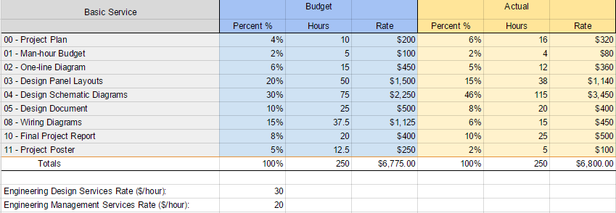
Engineering Man Hour Budget
Notes:
Sohail

Slide 10
Design Process
Drawing & Designs
One-line diagram, three-line diagram, key protection
Finalization
Design reviews – weekly meetings with Black and Veatch engineers
Design Justification
Substation layouts – Control building arrangement and panels
Schematics – Breaker relays, contacts, dc load center
Communication devices – router, distributed I/O module, and Ethernet switch
Protection relays – Primary, backup, and lowside
Component Selection
Develop Understanding
Look at Scope – Deliverables, project timeline, and I/O assignments
Learn substation design fundamentals (i.e. bus configuration, protection scheme, etc.)
Standard drawings
Notes:
Faran and (Bhargav???)
The presentation will clearly state how you have reached the current design (explain the process of design) and how the project progressed so far.
Develop Understanding: look through scope and input/output assignments that were given for relays
Black and veatch told us the requirements and we contacted SEL and configured the relay accordingly.
-Selecting proper relays from SEL to use in our protection drawings
-Selecting proper equipment for the communication scheme like selection CISCO equipment (Cisco Grid Router) for the cloud connection, (Cisco connected grid switch) forfiber and copper Ethernet connections
-Selecting orion lx RTU
Drawings
One-line Diagram
Three-line diagrams
Control Building Arrangement
Panel Layouts
AC/DC Schematics
Detail Wiring Diagrams
Final stages: Currently on this. Design Review: design evaluated against requirements

Slide 11
Technical Challenges
No datasheet for Cisco RTU equipment
Protection scheme development
Communication equipment selection
Black and Veatch standards
Notes:
MATT
No data sheet for cisco rtu equipment

Slide 12
Coherent Test Plan
Continuously reviewed work as sent
Formally review work
Notes:
Bhargav
The team is not expected to run simulations on the design nor do any formal testing. Verification of the design will be completed via review from external experts and design review meetings with the sponsor, Black and Veatch
As no formal testing is required for this project, the team will verify the design by conducting numerous design review meetings with experts in the field. Not only will the team advisor, Professor Ajjarapu, be supervising the design, the team will be consulting with engineers at the client company, Burns and McDonnell. This reflects the current internal review process utilized by B&V.

Slide 13
Possible Scenarios
Future growth
Weather
Smart Grid
Notes:
Sohail
8. You must show that you have thought of all possible scenarios when producing the design, and that you have prepared for all impossible scenarios by designing a good testing and debugging plan.
-extreme weather conditions can sometimes affect circuit breaker, relay protection, or the bus. So we need to design a proper HVAC system so there is proper cooling and proper heating of the protection relays
-we got something that was more powerful than we needed say something about future….
Weather stuff from design doc.
IEEE book

Slide 14
Demo

Slide 15
Substation Layout

Slide 16
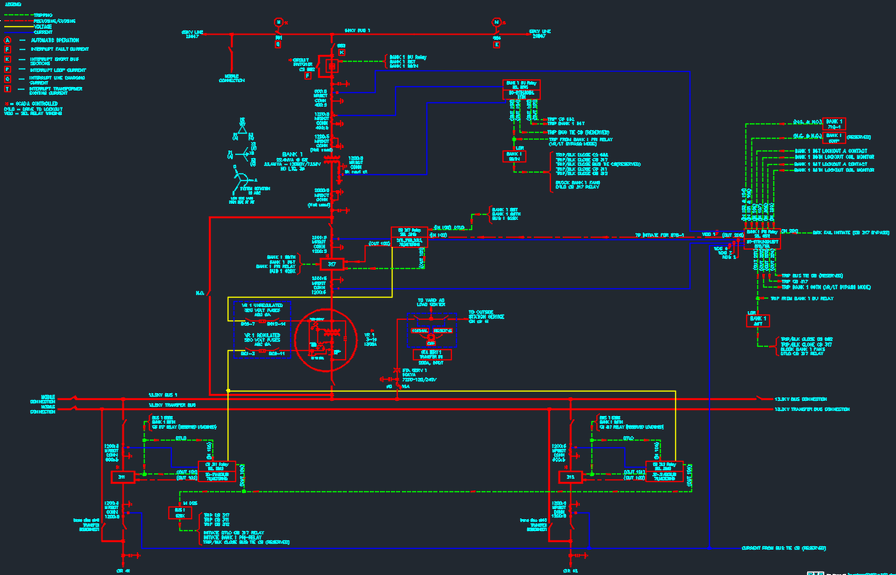
HV Side

Slide 17
High Voltage Side

Slide 18
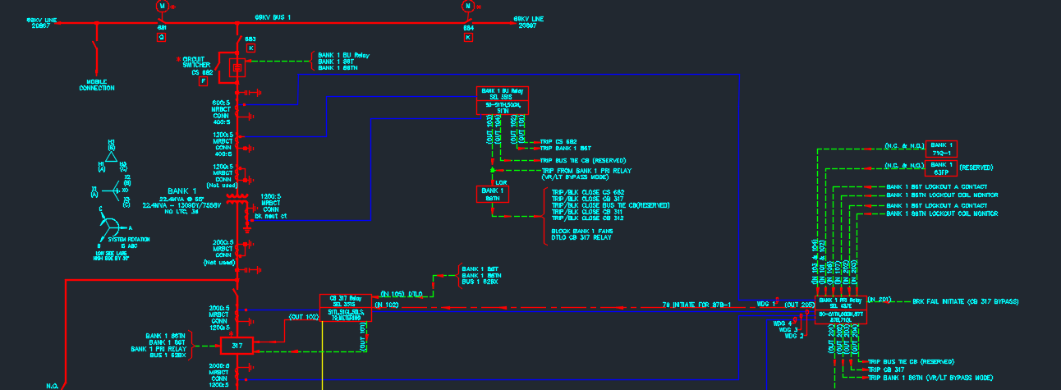
HV Side Zoomed In

Slide 19
Low Voltage Side

Slide 20
LV Side

Slide 21
LV Side Zoomed In
Feeder 1
Feeder 2

Slide 22
Primary Relay SEL 487E Transformer Protection Relay
Notes:
Matt

Slide 23
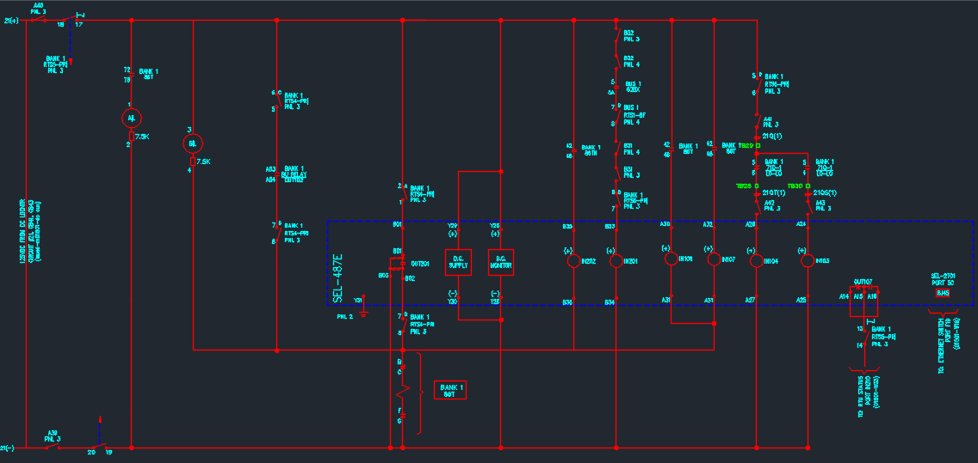

Slide 24
Back Up Relay SEL 351S
Notes:
Sohail

Slide 25
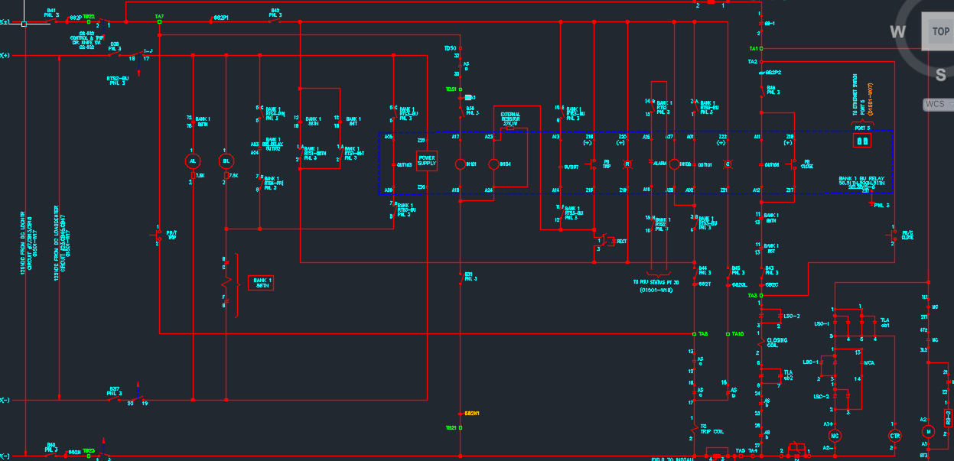

Slide 26
Lowside Relay SEL 351S
Notes:
Faran

Slide 27
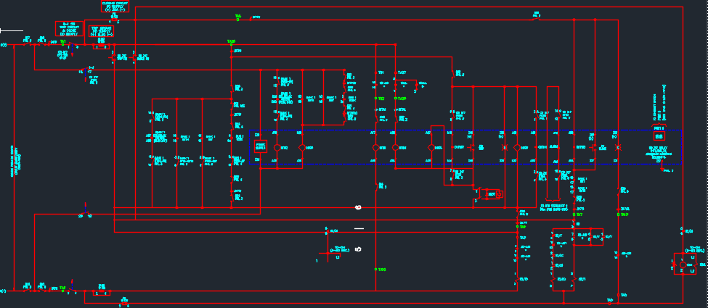

Slide 28
Bank Panel Layout (Primary, Back Up, & Lowside Relays)
Notes:
Ryan

Slide 29
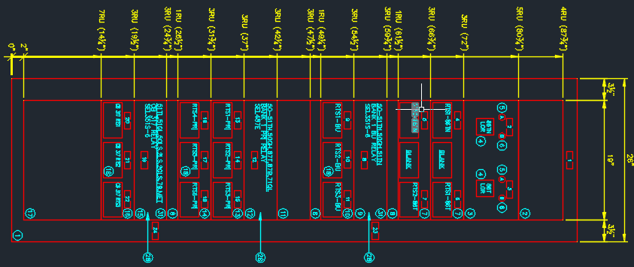
Lowside Relay
Primary Relay
Back Up Relay

Slide 30
Bus Panel Layout (Feeder 1 & Feeder 2 Relays)
Notes:
Sohail

Slide 31
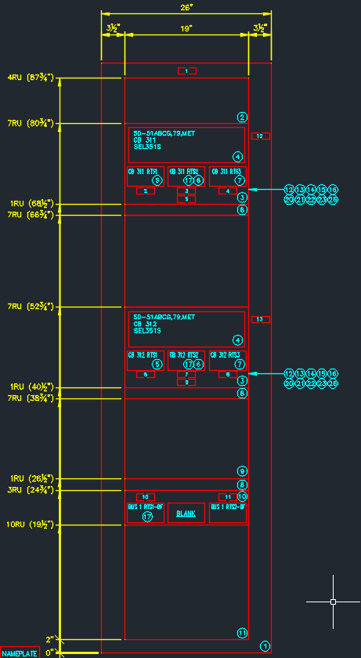
Feeder 1
Feeder 2

Slide 32
Communication Panel (SEL 2440 & Orion LX RTU)
Notes:
Matt

Slide 33
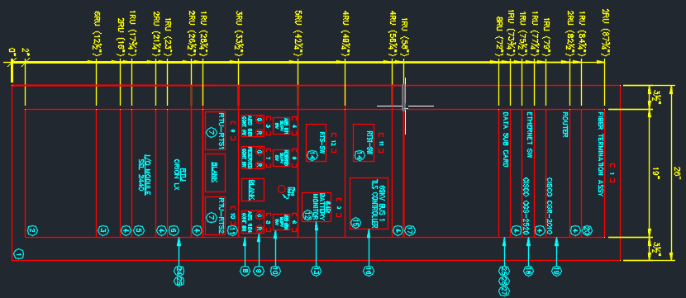
SEL 2411 (TLS Controller)
Orion LX RTU
SEL 2440 (Distributed I/O)

Slide 34
Control Building
Notes:
Faran

Slide 35
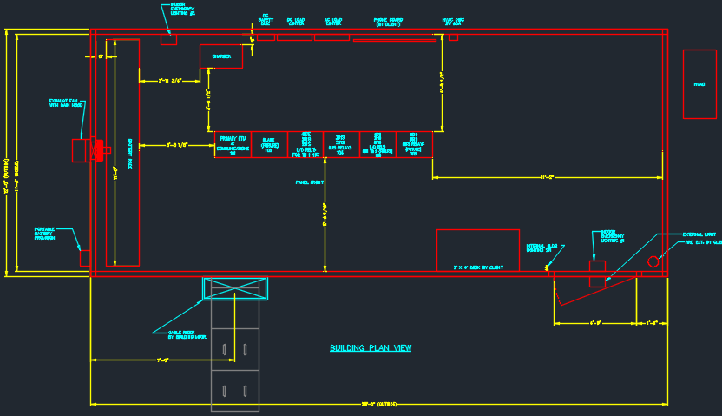

Slide 36
Three Line Diagram

Slide 37
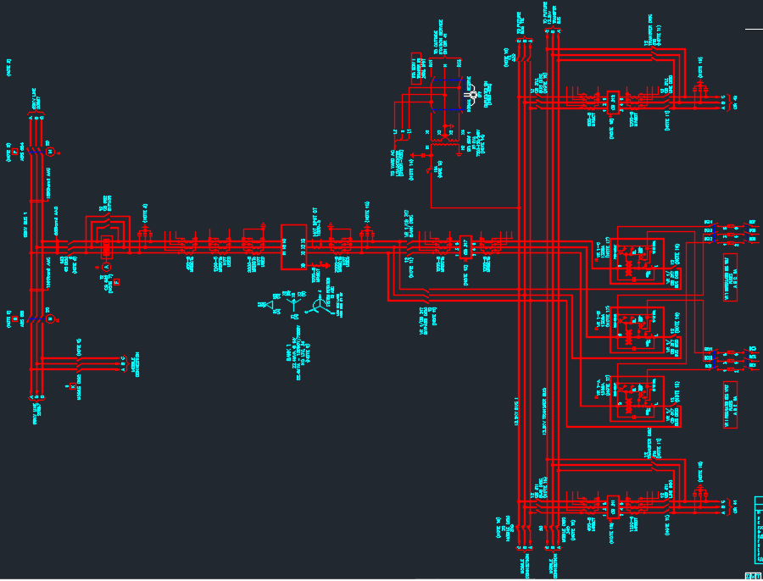

Slide 38
Thank you for your time!
Questions?
Notes:
20 mins

